Slide 1
Jain and Subramanian(2004)
0920 meeting

Slide 2
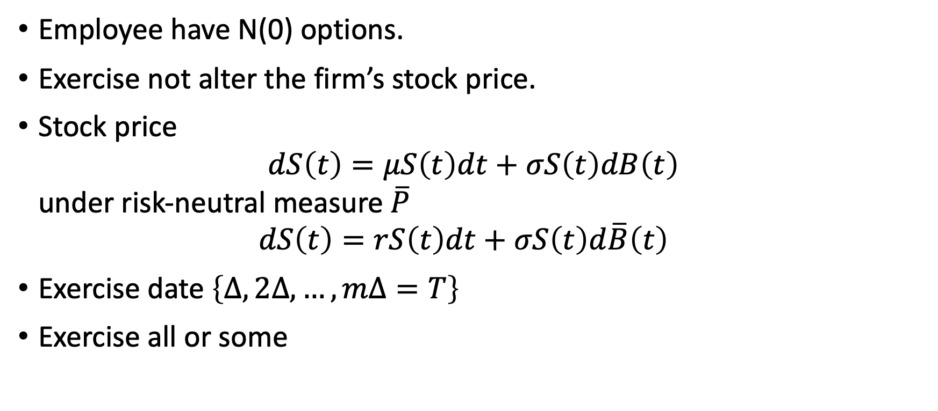
Model
Employee have N(0) options.
Exercise not alter the firm’s stock price.
Stock price $dS\left(t\right)=μS\left(t\right)dt+σS\left(t\right)dB\left(t\right)$ under risk-neutral measure $\overline{P}$ $dS\left(t\right)=rS\left(t\right)dt+σS\left(t\right)d\overline{B}\left(t\right)$
Exercise date $\left\{Δ, 2Δ, …, mΔ=T\right\}$
Exercise all or some

Slide 3
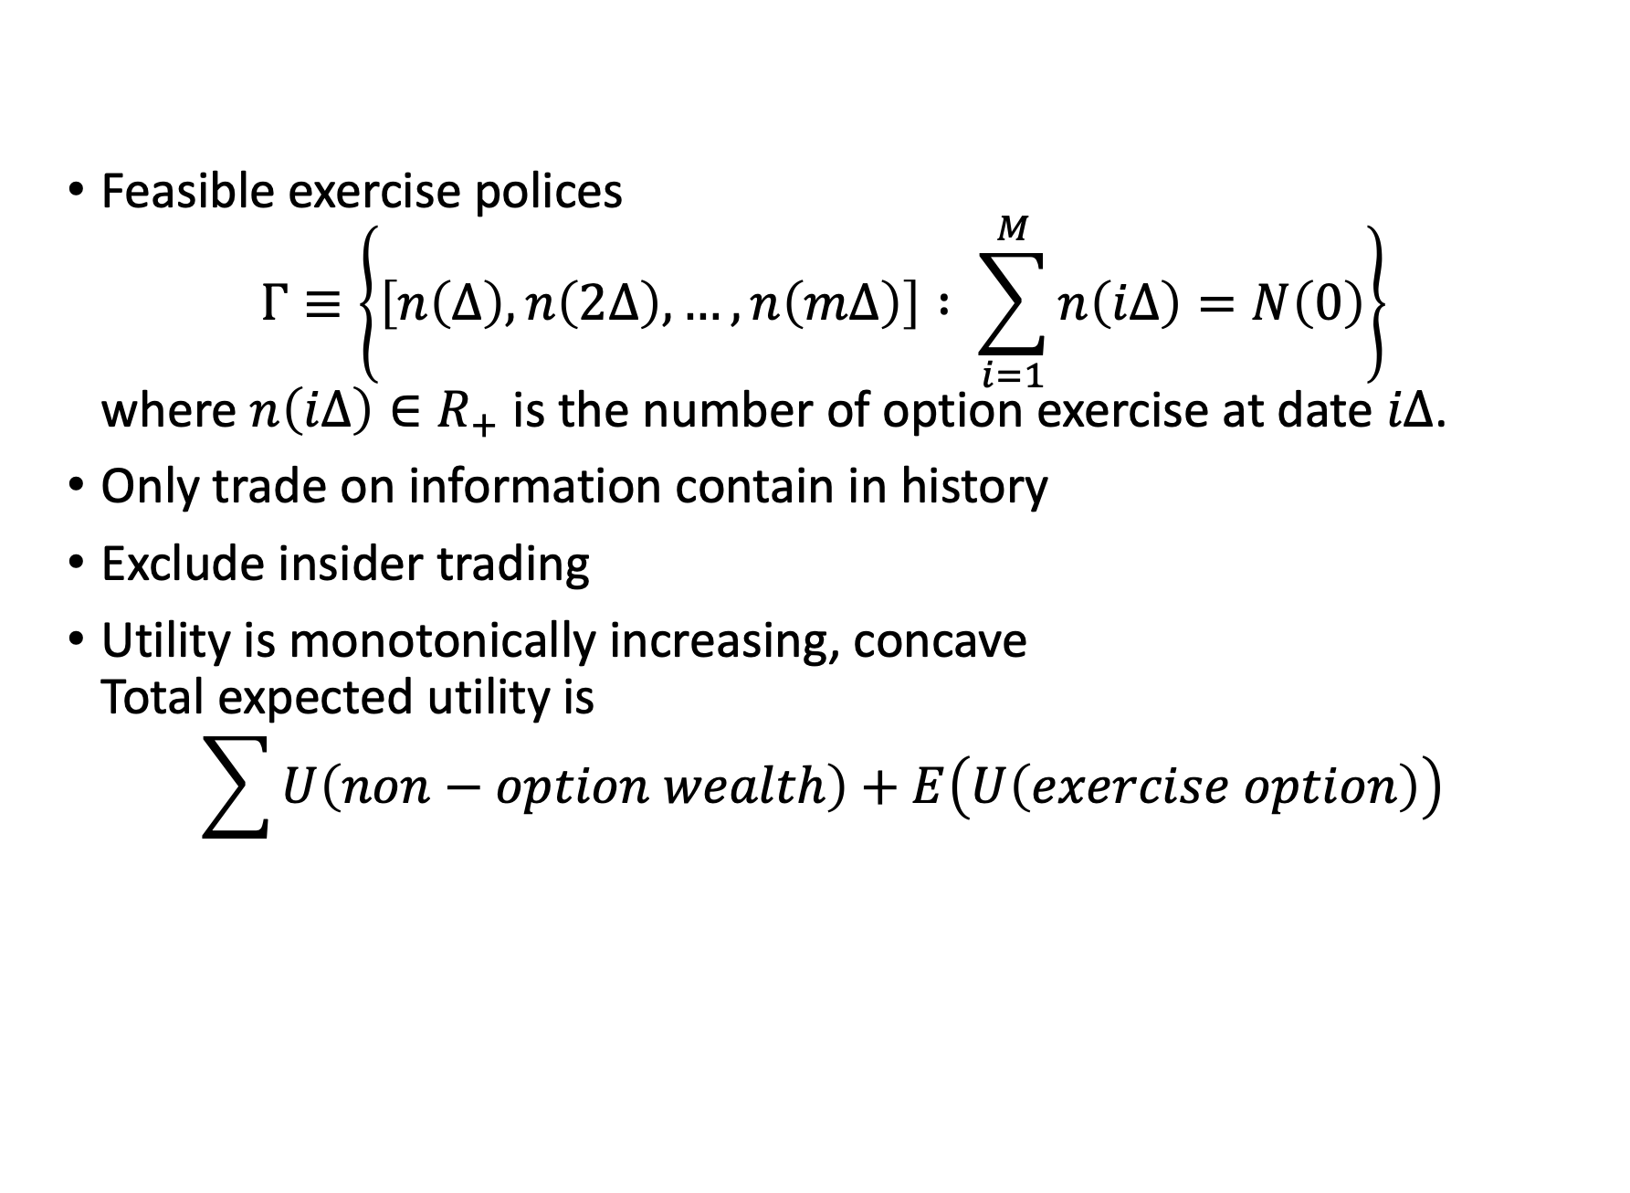
Model
Feasible exercise polices $Γ≡\left\{\left[n\left(Δ\right), n\left(2Δ\right), …, n\left(mΔ\right)\right] : \sum_{i=1}^{M}{n\left(iΔ\right)}=N\left(0\right)\right\}$ where $n\left(iΔ\right)∈R_{+}$ is the number of option exercise at date $iΔ$.
Only trade on information contain in history
Exclude insider trading
Utility is monotonically increasing, concave Total expected utility is $\sum{U\left(non−option wealth\right)}+E\left(U\left(exercise option\right)\right)$

Slide 4
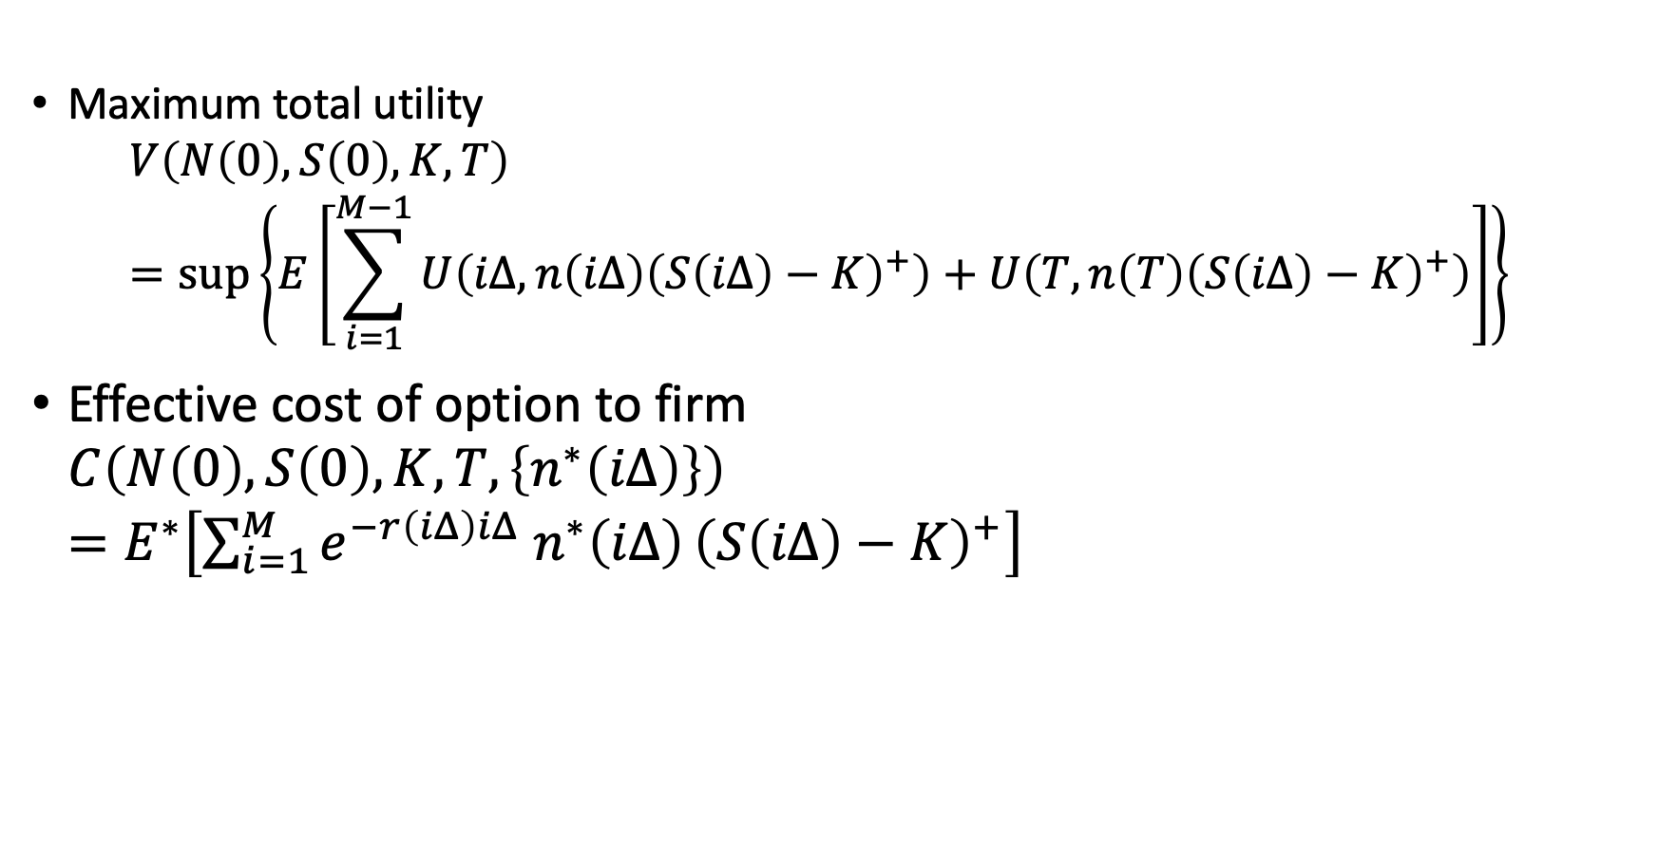
Model
Maximum total utility $V\left(N\left(0\right), S\left(0\right), K, T\right)$ $=\sup\left\{E\left[\sum_{i=1}^{M−1}{U\left(iΔ, n\left(iΔ\right){\left(S\left(iΔ\right)−K\right)}^{+}\right)+U\left(T, n\left(T\right){\left(S\left(iΔ\right)−K\right)}^{+}\right)}\right]\right\}$
Effective cost of option to firm $C\left(N\left(0\right), S\left(0\right), K, T, \left\{n^{∗}\left(iΔ\right)\right\}\right)$ $=E^{∗}\left[\sum_{i=1}^{M}{e^{−r\left(iΔ\right)iΔ} n^{∗}\left(iΔ\right)}{\left(S\left(iΔ\right)−K\right)}^{+}\right]$

Slide 5
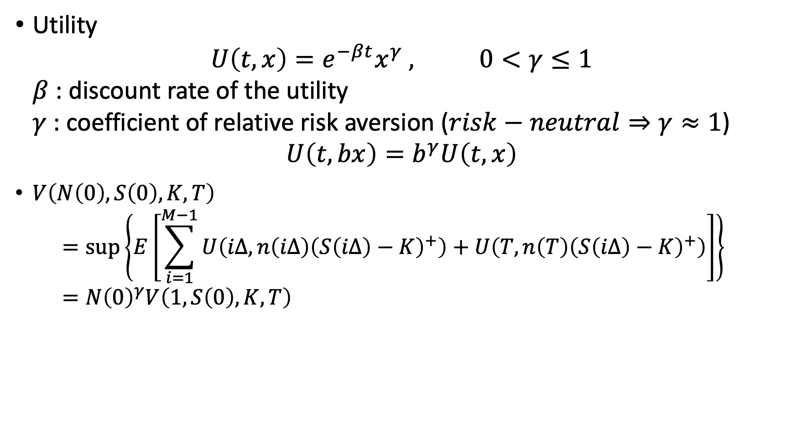
Model
Utility $U\left(t,x\right)=e^{−βt}x^{γ} , 0<γ≤1$ $β$ : discount rate of the utility $γ$ : coefficient of relative risk aversion ($risk−neutral⇒γ≈1$)
$$U\left(t,bx\right)=b^{γ}U\left(t,x\right)$$
$V\left(N\left(0\right), S\left(0\right), K, T\right)$ $=\sup\left\{E\left[\sum_{i=1}^{M−1}{U\left(iΔ, n\left(iΔ\right){\left(S\left(iΔ\right)−K\right)}^{+}\right)+U\left(T, n\left(T\right){\left(S\left(iΔ\right)−K\right)}^{+}\right)}\right]\right\}$ $=N{\left(0\right)}^{γ}V\left(1, S\left(0\right), K, T\right)$

Slide 6
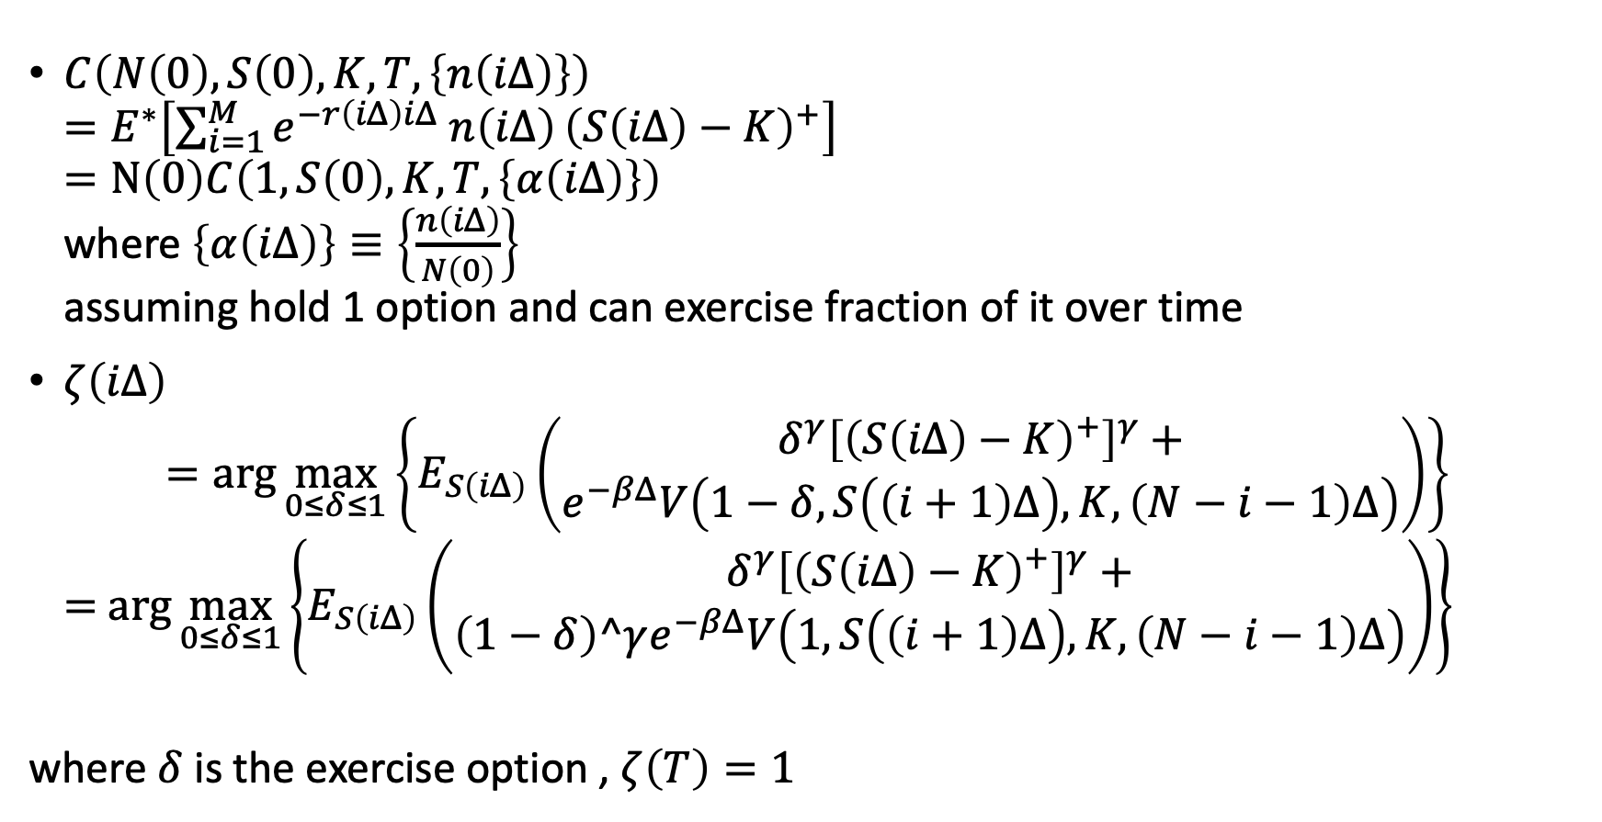
Model
$C\left(N\left(0\right), S\left(0\right), K, T, \left\{n\left(iΔ\right)\right\}\right)$ $=E^{∗}\left[\sum_{i=1}^{M}{e^{−r\left(iΔ\right)iΔ} n\left(iΔ\right)}{\left(S\left(iΔ\right)−K\right)}^{+}\right]$ $=N\left(0\right)C\left(1, S\left(0\right), K, T, \left\{α\left(iΔ\right)\right\}\right)$ where $\left\{α\left(iΔ\right)\right\}≡\left\{\frac{n\left(iΔ\right)}{N\left(0\right)}\right\}$ assuming hold 1 option and can exercise fraction of it over time
$ζ\left(iΔ\right)$ $=\arg{\max_{0≤δ≤1}\left\{E_{S\left(iΔ\right)}\left(\begin{aligned}δ^{γ}{\left[{\left(S\left(iΔ\right)−K\right)}^{+}\right]}^{γ}+ \\ e^{−βΔ}V\left(1−δ,S\left(\left(i+1\right)Δ\right),K,\left(N−i−1\right)Δ\right)\end{aligned}\right)\right\}}$ $=$ $\arg{\max_{0≤δ≤1}\left\{E_{S\left(iΔ\right)}\left(\begin{aligned}δ^{γ}{\left[{\left(S\left(iΔ\right)−K\right)}^{+}\right]}^{γ}+ \\ \left(1−δ\right)^γe^{−βΔ}V\left(1,S\left(\left(i+1\right)Δ\right),K,\left(N−i−1\right)Δ\right)\end{aligned}\right)\right\}}$
where $δ$ is the exercise option , $ζ\left(T\right)=1$

Slide 7

Model
Differentiating the expression on right-hand side of above equation with respect to $δ$ , we obtain $ζ\left(Δ\right)$ $=\frac{{\left[E_{S\left(iΔ\right)}e^{−βΔ}\left(V\left(1,S\left(\left(i+1\right)Δ\right),K,\left(N−i−1\right)Δ\right)\right)\right]}^{\frac{1}{γ−1}}}{{\left[{\left(S\left(iΔ\right)−K\right)}^{+}\right]}^{\frac{γ}{γ−1}}+{\left[E_{S\left(iΔ\right)}e^{−βΔ}\left(V\left(1,S\left(\left(i+1\right)Δ\right),K,\left(N−i−1\right)Δ\right)\right)\right]}^{\frac{1}{γ−1}}}$

Slide 8
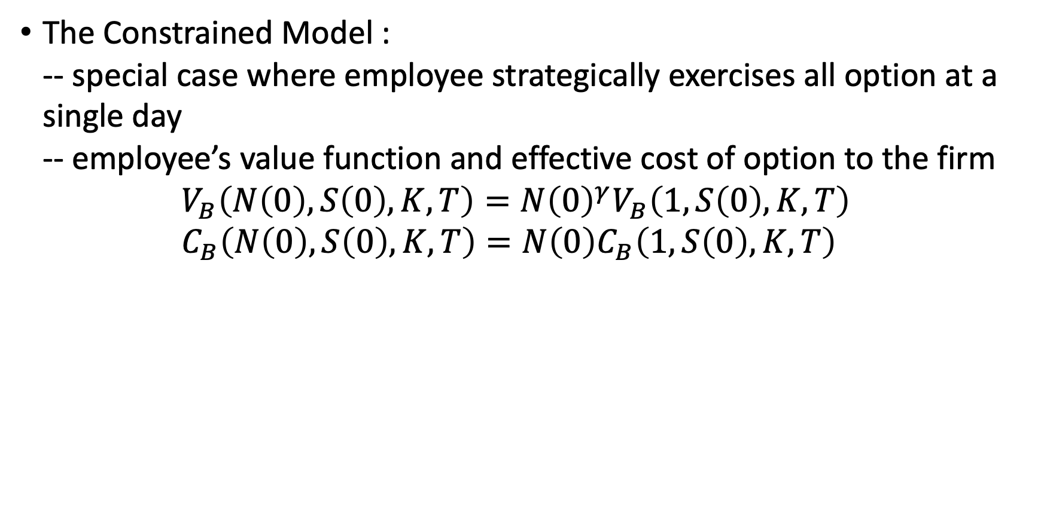
Model
The Constrained Model : -- special case where employee strategically exercises all option at a single day -- employee’s value function and effective cost of option to the firm $V_{B}\left(N\left(0\right),S\left(0\right),K,T\right)=N{\left(0\right)}^{γ}V_{B}\left(1,S\left(0\right),K,T\right)$ $C_{B}\left(N\left(0\right),S\left(0\right),K,T\right)=N\left(0\right)C_{B}\left(1,S\left(0\right),K,T\right)$

Slide 9
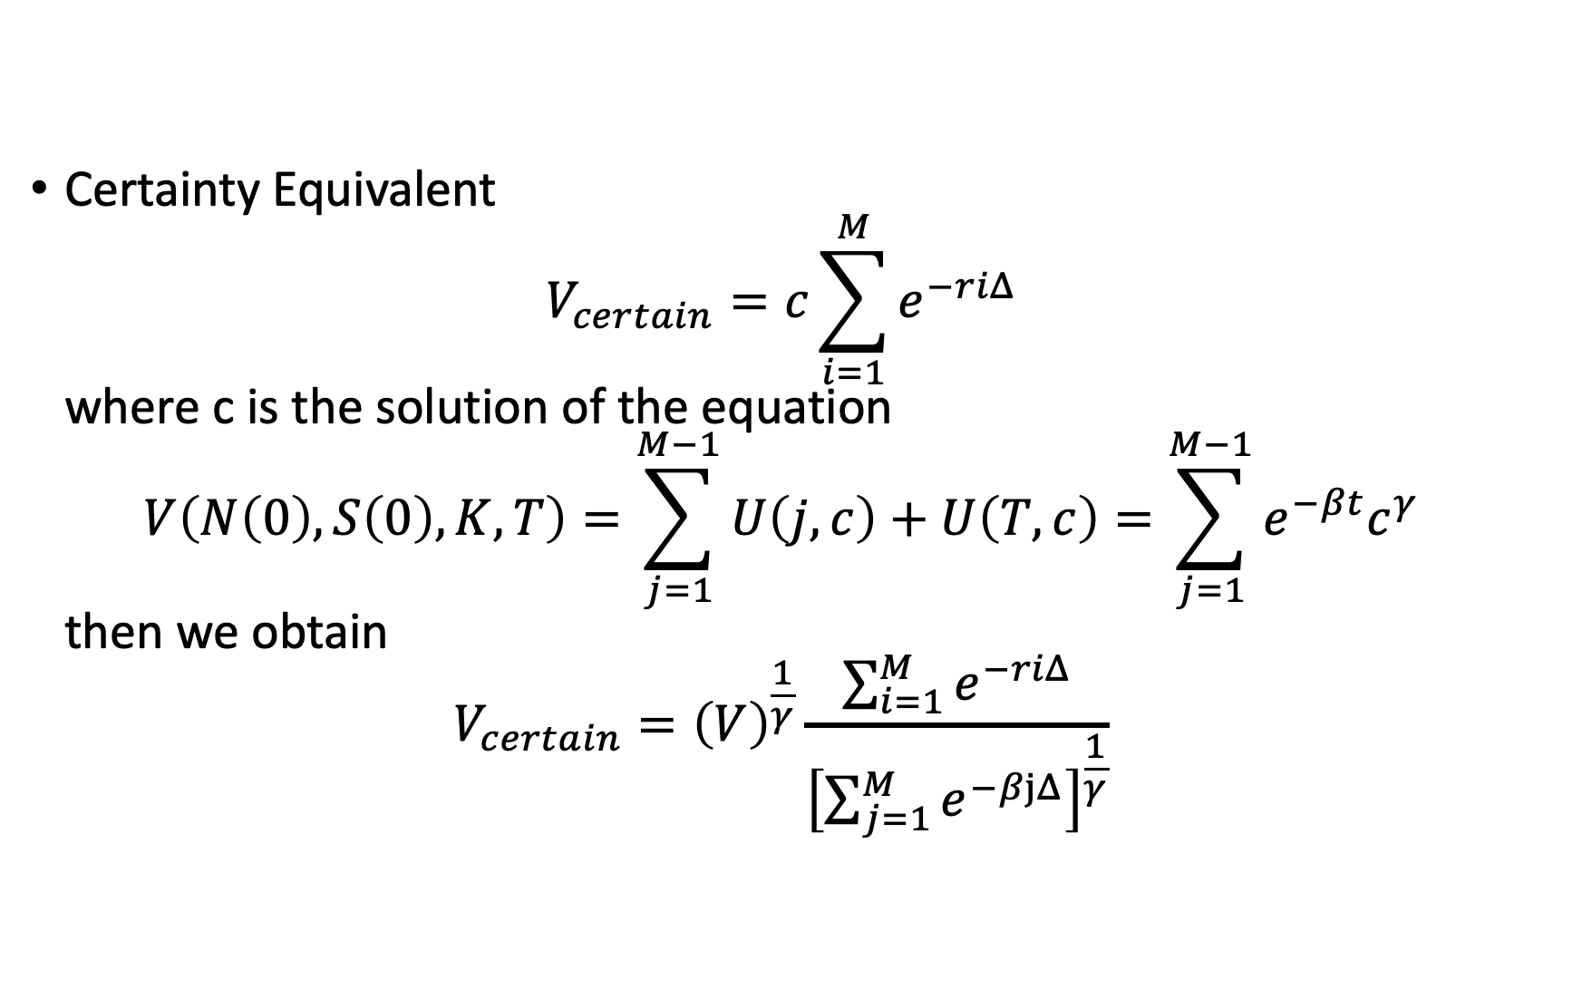
Model
Certainty Equivalent $V_{certain}=c\sum_{i=1}^{M}{e^{−riΔ}}$ where c is the solution of the equation $V\left(N\left(0\right),S\left(0\right),K,T\right)=\sum_{j=1}^{M−1}{U\left(j,c\right)+U\left(T,c\right)}=\sum_{j=1}^{M−1}{e^{−βt}c^{γ}}$ then we obtain $V_{certain}={\left(V\right)}^{\frac{1}{γ}}\frac{\sum_{i=1}^{M}{e^{−riΔ}}}{{\left[\sum_{j=1}^{M}{e^{−βjΔ}}\right]}^{\frac{1}{γ}}}$

Slide 10
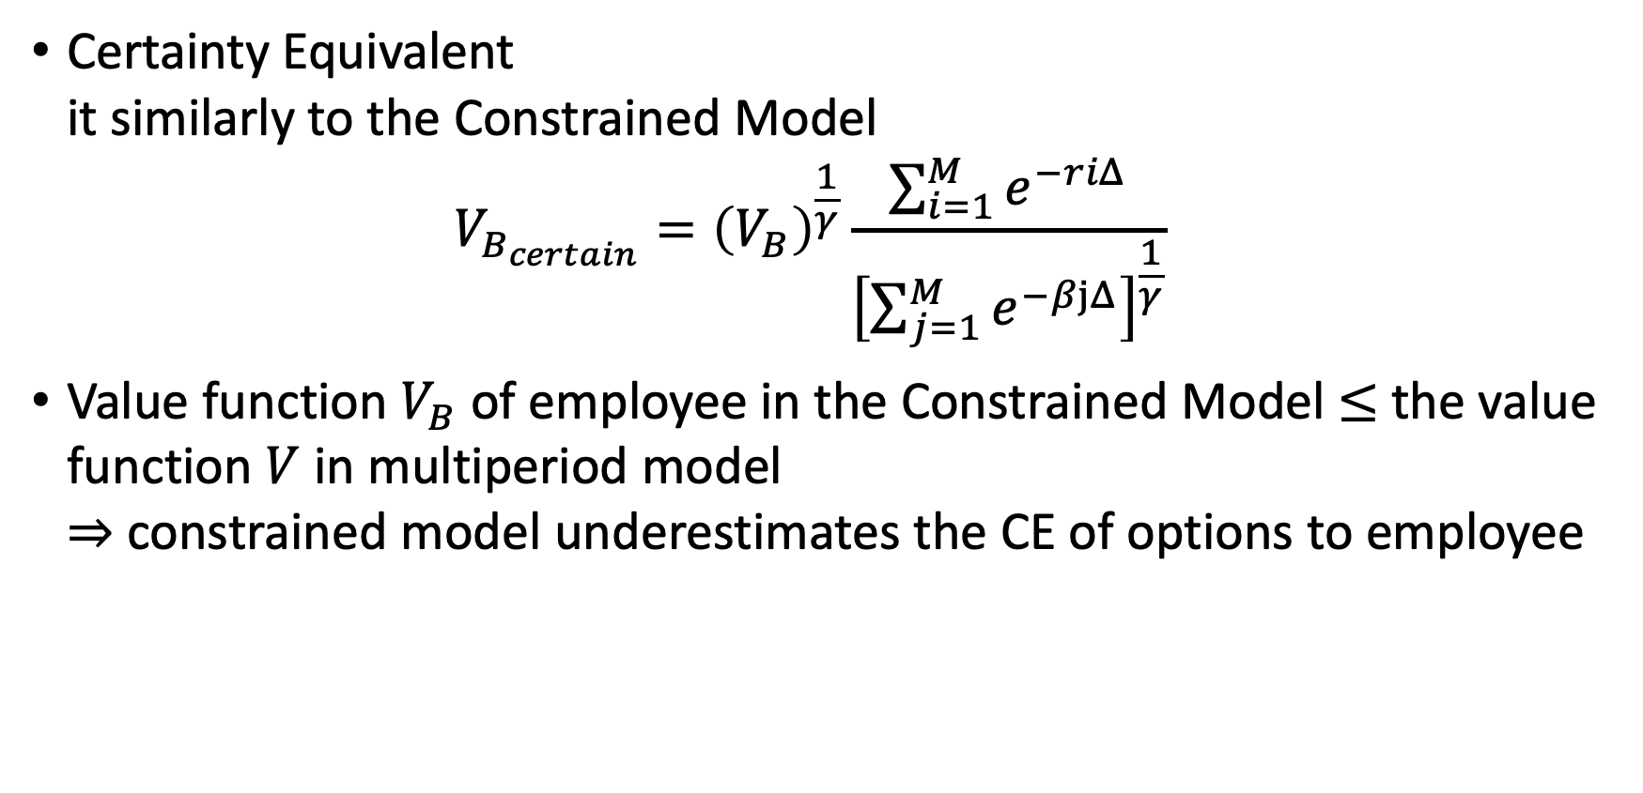
Model
Certainty Equivalent it similarly to the Constrained Model $V_{B_{certain}}={\left(V_{B}\right)}^{\frac{1}{γ}}\frac{\sum_{i=1}^{M}{e^{−riΔ}}}{{\left[\sum_{j=1}^{M}{e^{−βjΔ}}\right]}^{\frac{1}{γ}}}$
Value function $V_{B}$ of employee in the Constrained Model $≤$ the value function $V$ in multiperiod model $⇒$ constrained model underestimates the CE of options to employee

